Slide 1


Scalable compute platform with add-on storage, security, and monitoring capabilities
1
n00bz{D1g1t4l_0c34n
Notes:
We make it simple to launch in the cloud and scale up as you grow—whether you’re running one virtual machine or ten thousand.

Slide 2



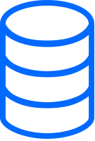
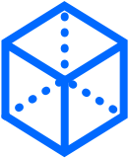




Seamless management of infrastructure
Droplets
Scalable compute services
Managed Databases
Worry-free setup & maintenance
Spaces
Simple object storage
Kubernetes
Run managed Kubernetes clusters
Load Balancers
Easily distributed traffic
Block Storage
Attach scalable volumes
One-Click Apps
Deploy pre-built application
1s_5p0n50r1ng

Slide 3


London
Amsterdam
Toronto
Frankfurt
San Francisco
New York
Across 12 data centers in 8 global markets
Bangalore
Singapore
1500+
1.2PB+
50PB
peers around the world
of RAM
of storage
3
_
U5_2000_d0ll4r5_

Slide 4
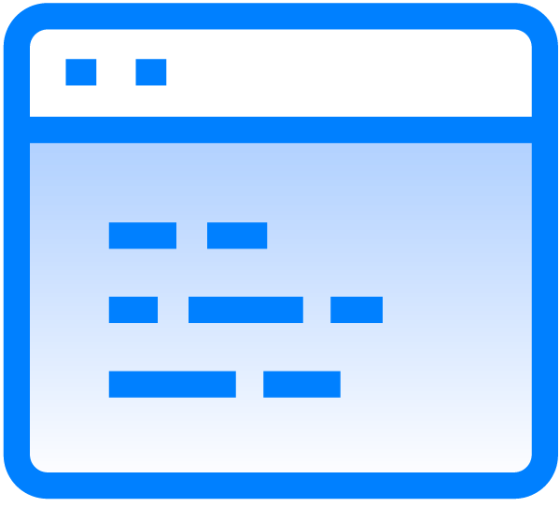



Why customers love DigitalOcean
Simplicity
Community
Service
Open source
Intuitive & conveniently packaged services
Developer community engagement & education
Heartfelt support & unparalleled service
Open source advantages & cloud-native architecture
4
4
w
0
r
7
H
_0
F
_cr3d1t5
Notes:
We make it simple to launch in the cloud and scale up as you grow—whether you’re running one virtual machine or ten thousand.

Slide 5
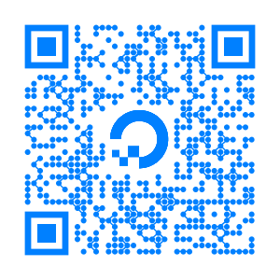
Try DigitalOcean
Scan this QR code for a $100, 60-day free trial
Or simply go to: try.digitalocean.com/developer-cloud
_
7
H
4
N
K
_
Y0
U
_s0
-
much}

